Slide 1
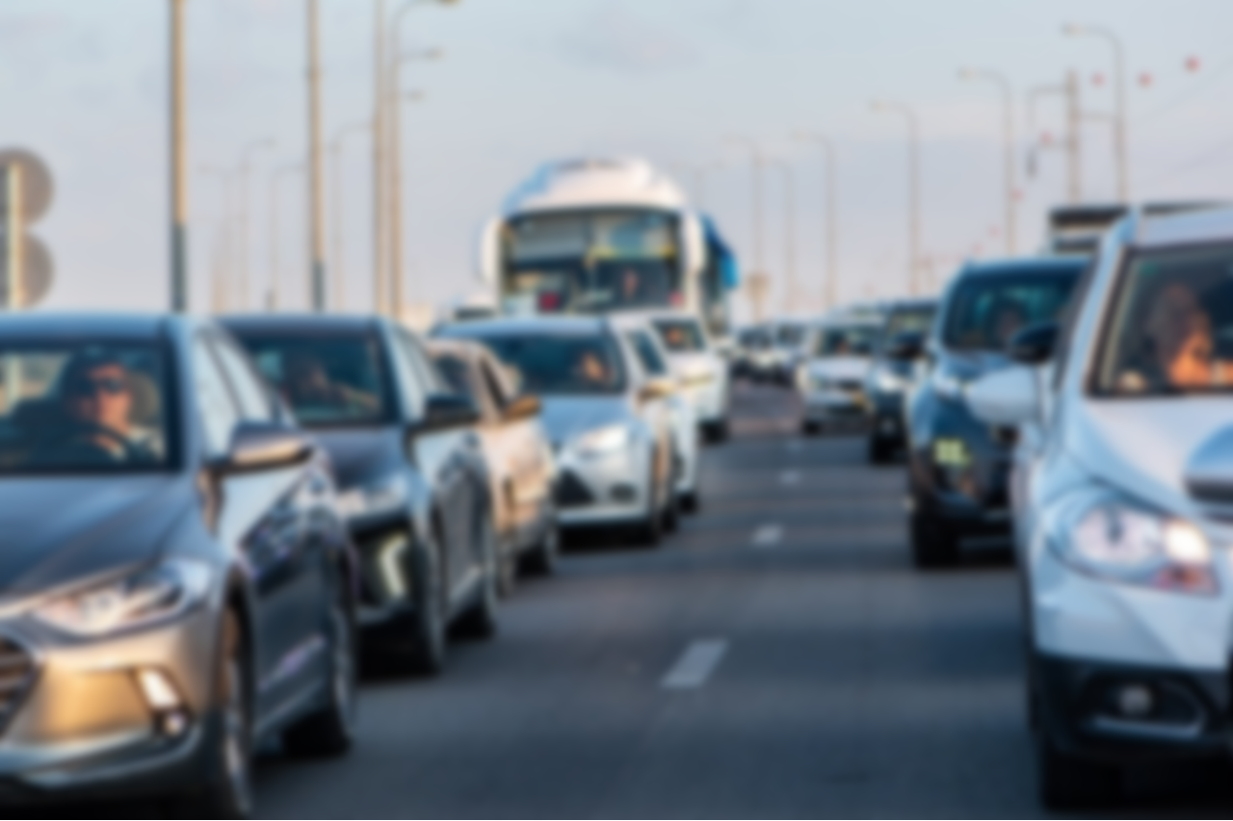
SilentSignal
A Noiseless Vehicle Horn System

Slide 2
Aust_Vigilantes
Abrar Khan Alvi
20210104016
Fahari Alam Rashed
20210104017
H.M. Ziyad
20210104023
Afia Fahmida
20210104032

Slide 3
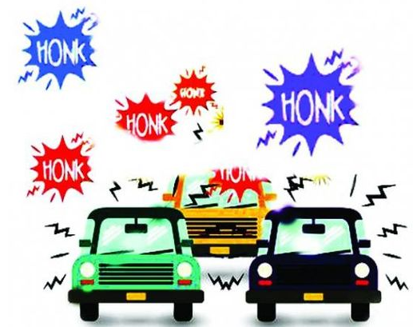
Contents
Problem-Solution
Social & Economic Development
Required Components
Implementation
Multidisciplinary
Our Motive
Conclusion

Slide 4

Problem
Noise Pollution
Negative Impact on Health
Safety Concerns
Distraction and Reduced Concentration

Slide 5


Solution
SilentSignal
Internalized Communication
Selective Signaling
Reduced Honking Frequency
Improved Quality of Life

Slide 6
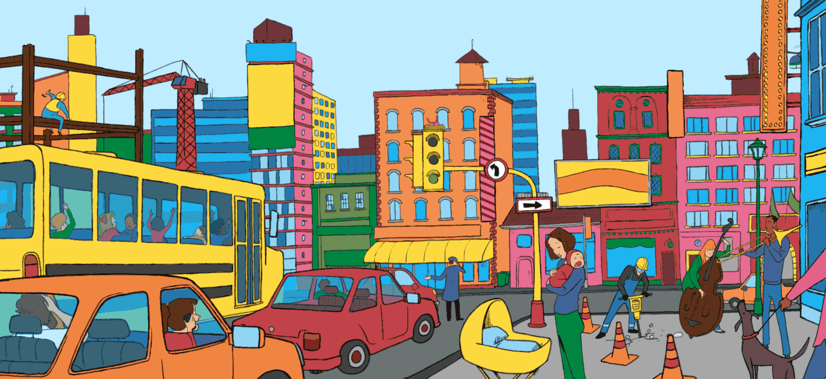
Social & Economics Development
External Stakeholders: General people, society, government
Internal Stakeholders: Investors, engineers contributing in the implementation process

Slide 7
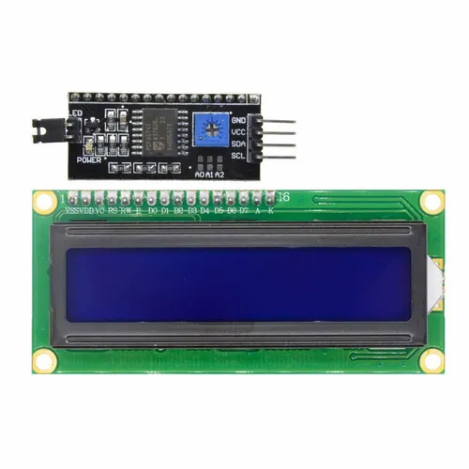
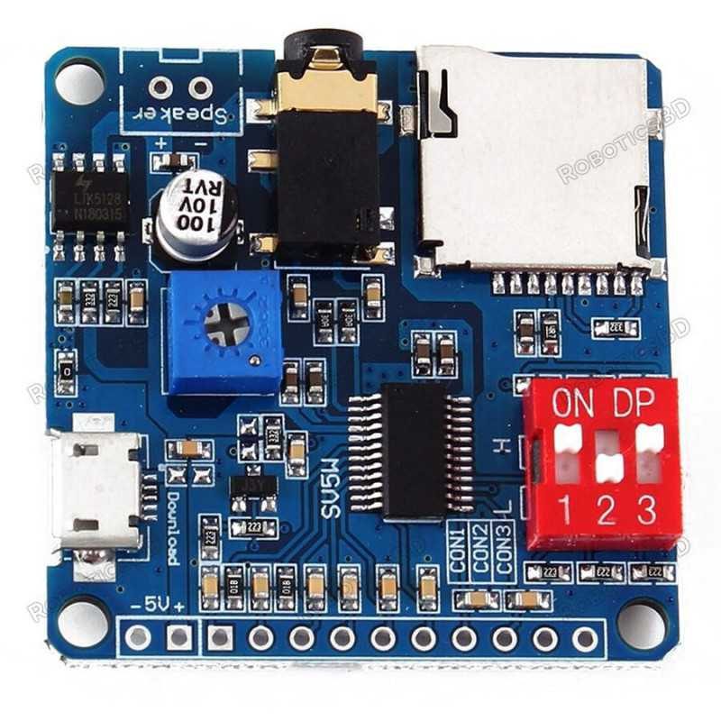
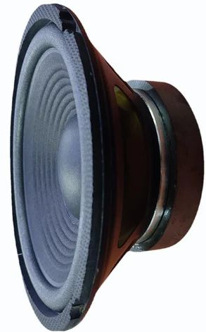
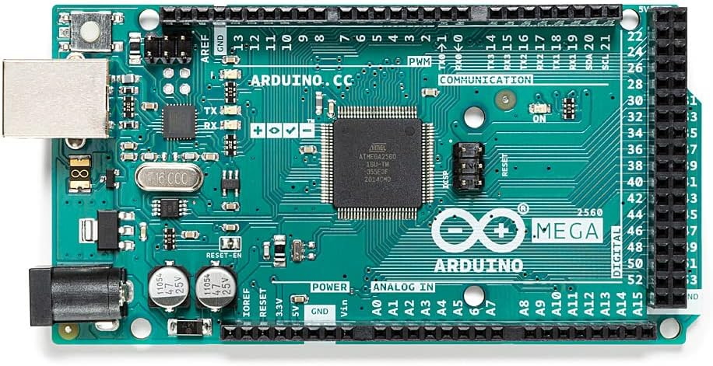
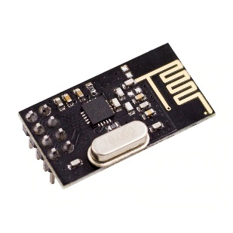
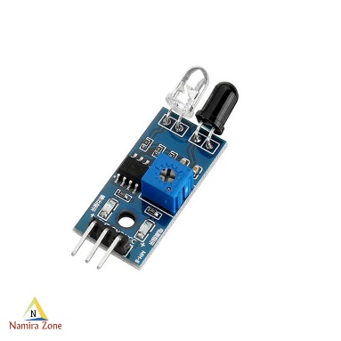
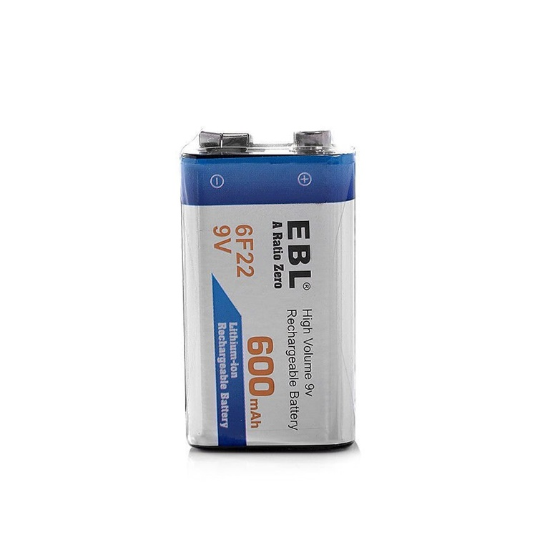
Required Components
Arduino Boards
16x2 Serial LCD Modules
NRF24L01+ 2.4GHz Wireless Transceiver Modules
IR Sensors
Audio Driver Module
Batteries
Jumper Wires

Slide 8
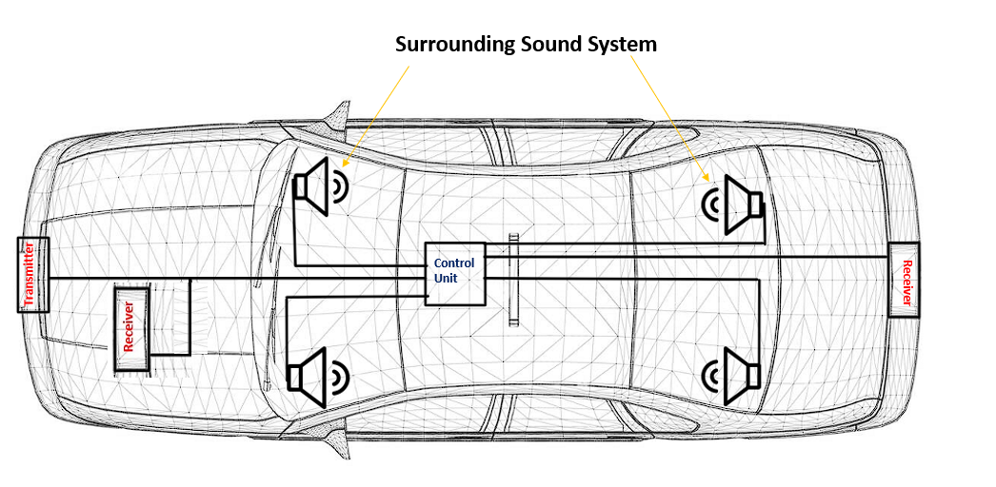
Implementation

Slide 9
Working Procedure
The basic components that react to the input are
• 16x2 Serial LCD Modules
• NRF24L01+ 2.4GHz Wireless Transceiver Modules (Transmitter Mode)
• Audio Driver Modules
• Speakers
The components that receive commands
• NRF24L01+ 2.4GHz Wireless Transceiver Modules (Receiver Mode)
• IR sensors

Slide 10
Multidisciplinary
Language: C++
IDE: Proteus 8 Professional, Arduino IDE

Slide 11
Estimated Budget
• Arduino Mega 2560 R3: BDT 1895
• Arduino UNO: BDT 840
• Arduino NANO: BDT 600
• 16x2 Serial LCD Module (x2): BDT 220 each
• NRF24L01+ 2.4GHz Wireless Transceiver Module (x6): BDT 199 each
• IR Sensors (as required): BDT 90
• Audio Driver Module (x2): BDT 700
• LED (as required): BDT 2.5
• Batteries (as required): BDT 1000
• Jumper Wires (as required): BDT 100
Total Budget: BDT 8000 (approximately)

Slide 12

Conclusion
For the sake of a peaceful society
Eradicating accidents
Reference
https://www.researchgate.net/publication/338107992_Design_of_a_Smart_Real-time_Excessive_Honking_Control_System
https://www.irjmets.com/uploadedfiles/paper/issue_5_may_2022/24235/final/fin_irjmets1654229519.pdf

Slide 13
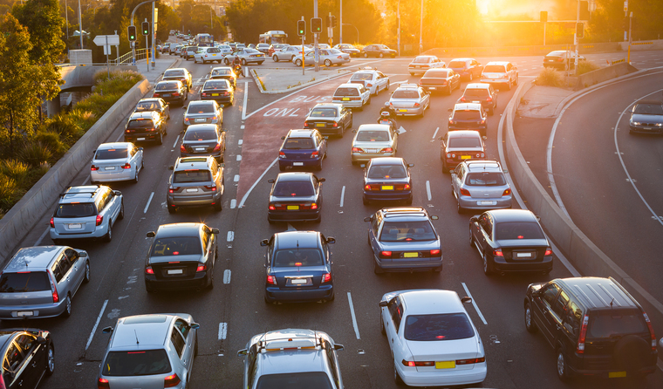
Thank You
Any Questions?

